Slide 1

Predicting Academic Success: A foundational step towards personalized education
Presenter: Samson Dawit Bekele
2nd Course, Department of Computer Science, FIT, Al-Farabi Kazakh National University
Advisor: Assoc. Prof., PhD, Imankulov Timur Sakenovich
Digital Farabi, February 2024

Slide 2
Previous Studies
Proposed Solution
Luan, H., & Tsai, C.-C. (2021). A Review of Using Machine Learning Approaches for Precision Education. Educational Technology & Society, 24(1), 250–266.
Ng, Y.-K., & Linn, J. (2017). CrsRecs: A personalized course recommendation system for college students. 2017 8th International Conference on Information, Intelligence, Systems & Applications (IISA).
Shawky, D.M., & Badawi, A.H. (2018). Towards a Personalized Learning Experience Using Reinforcement Learning. Machine Learning Paradigms.
Predicting academic success is a critical first step towards personalized education.
It enables educators to identify individual learners' strengths, weaknesses, and learning preferences.
The built model identifies key features and patterns that influence academic outcomes.
Allows for early interventions and the proactive design of tailored resources and learning strategies.
Note: Most studies highlight the challenge faced by personalizing education due to lack of data. All don’t consider student preference AND performance.
Problem Statement
One-size-fits-all education model
Lack of data
Notes:
Predicting enables educators and learning systems to identify individual learners' strengths, weaknesses, and learning preferences

Slide 3
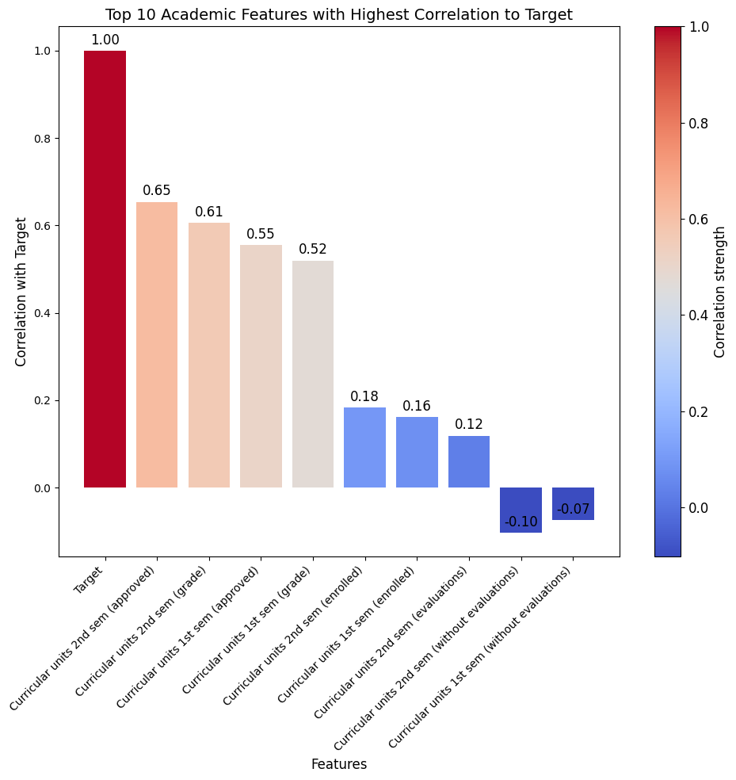
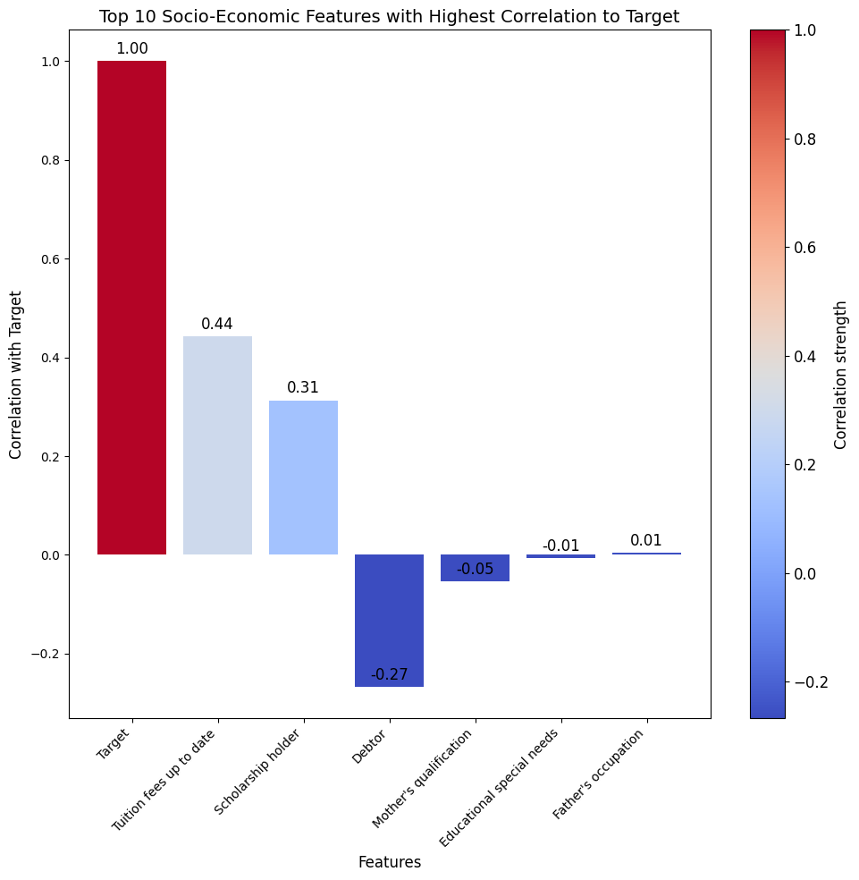
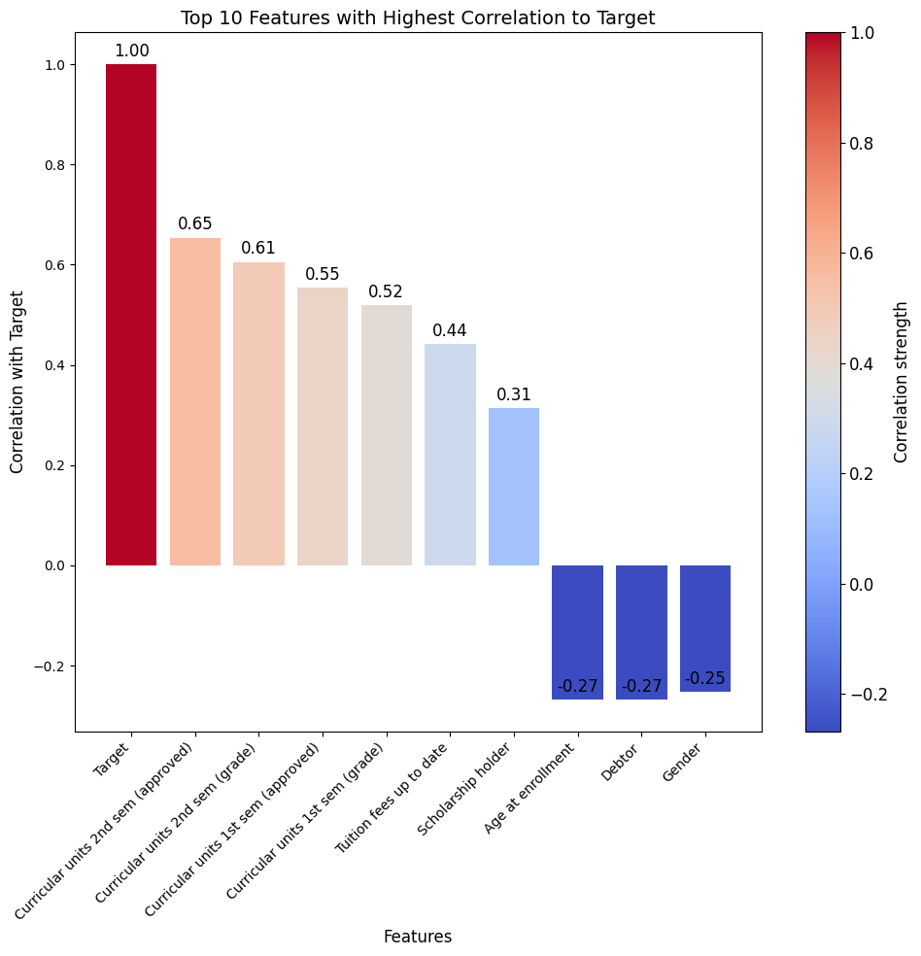
1. Dataset
Real dataset from a higher education institution in Portugal, containing 4424 student datapoints.
36 academic, demographic, macro and academic enrollment, and socio-economic features
The dataset was preprocessed and cleaned before the training process

Slide 4
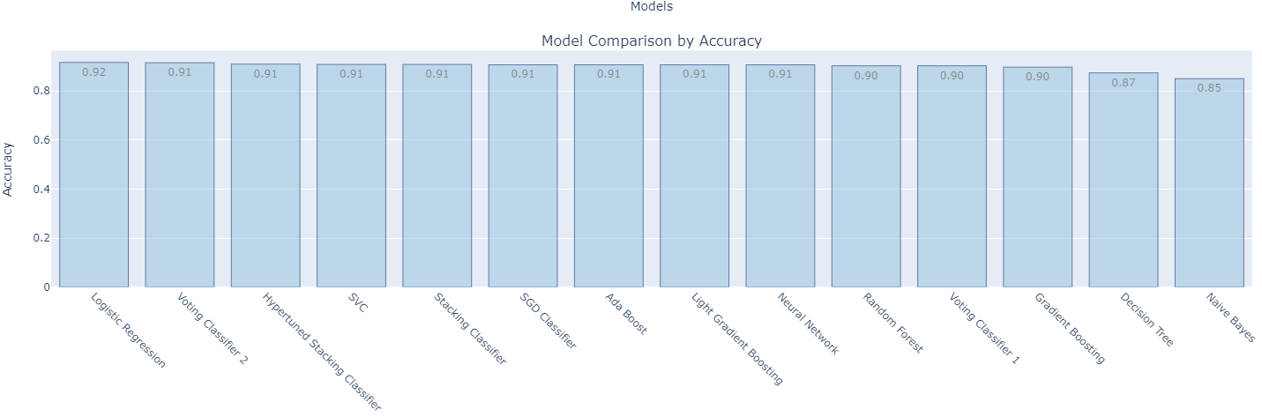
2. Machine Learning Models
The dataset was divided into 20% test and 80% train.
14 Machine learning techniques were used, and their performance was compared to choose the best one.
Hyperparameter tuning was conducted using GridSearchCV for optimal results.
Logistic Regression: 92% Accuracy

Slide 5
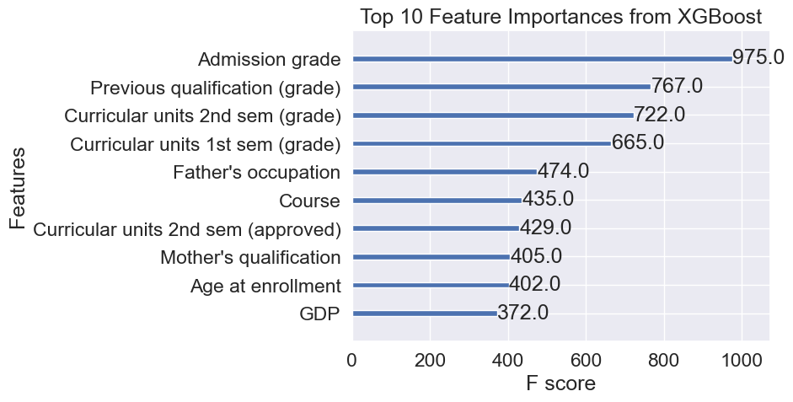
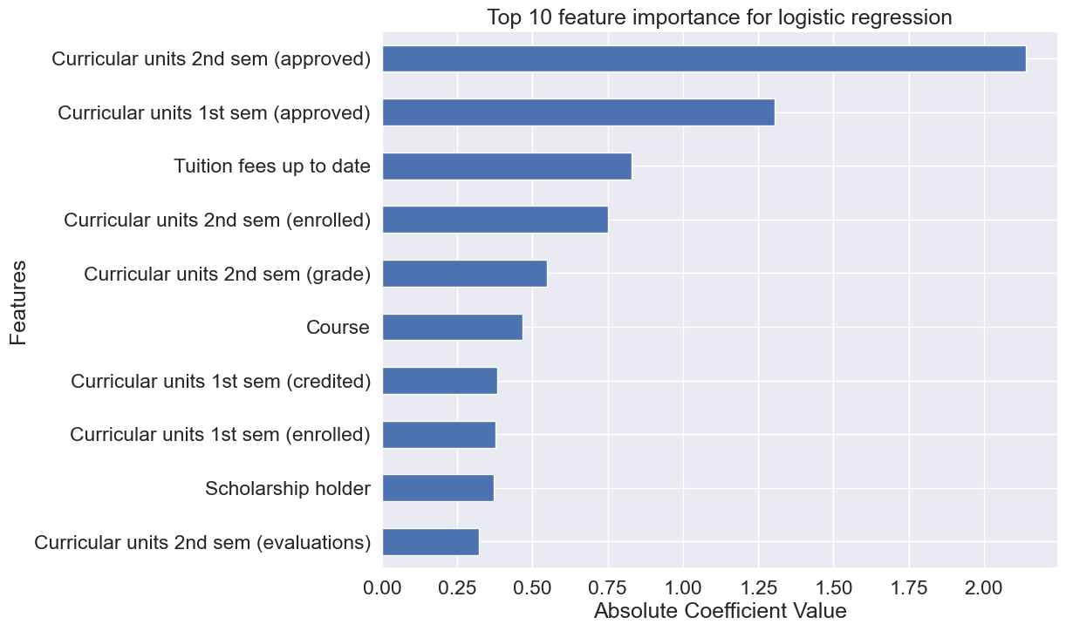
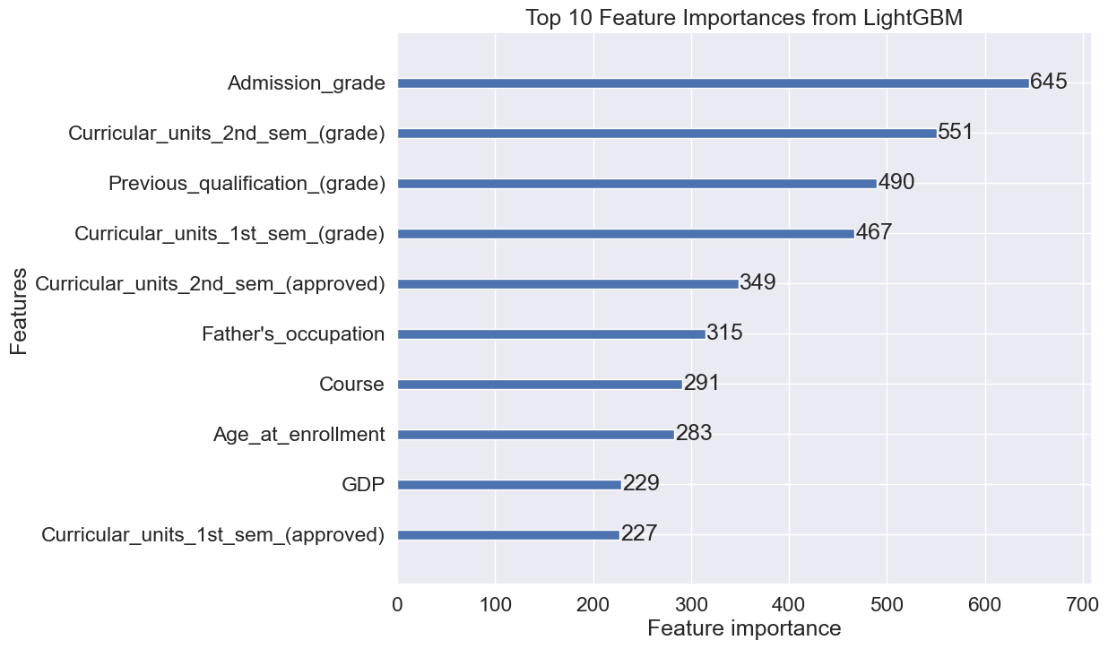
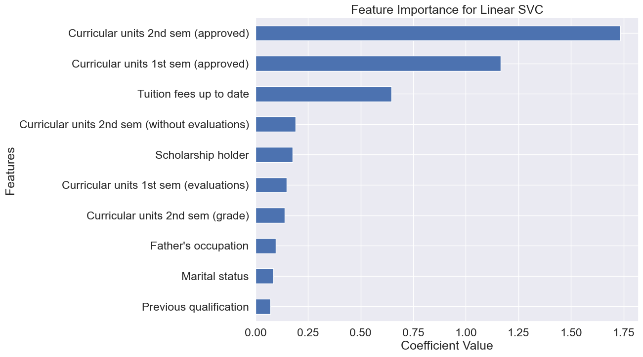
3. Feature Importance
What are the main factors?
1. Academic
2. Socio-economic
Notes:
By understanding which features are most important, educators and the AI system can understand what impacts student performance the most. For instance, if 'Tuition fees up to date' has high importance, it might indicate financial stability is a significant predictor of academic success.
If certain academic-related features, such as 'Curricular units 2nd semester (grade)', are identified as highly important, this suggests that recent academic performance should weigh heavily in personalizing future course recommendations.

Slide 6
Future Work and Considerations
Creating our own dataset from KazNU by creating a comprehensive and ethical survey to integrate personalization variables, as done by Nabizadeh, S. et al¹.
Integrate the developed system into Univer to develop a real-time recommendation system.
Collaborate with other universities for a more representative sampling.
Explore ranking and recommendation algorithms.
Nabizadeh, S., Hajian, S., Sheikhan, Z., & Rafiei, F. (2019). Prediction of academic achievement based on learning strategies and outcome expectations among medical students. In BMC Medical Education (Vol. 19, Issue 1). Springer Science and Business Media LLC. https://doi.org/10.1186/s12909-019-1527-9

Slide 7
Thank you
Presenter: Samson Dawit Bekele
Advisor: Assoc. Prof., PhD, Imankulov Timur Sakenovich

